Slide 1



Primitives, Objects, and Heap/Stack
Review 1
Chris Piech
CS106A, Stanford University

Slide 2
Plan for today
Announcements/Exam logistics
Tracing
1D Arrays
2D Arrays
ArrayList

Slide 3
Plan for tomorrow
Announcements/Exam logistics
HashMaps
Classes
Interactors

Slide 4
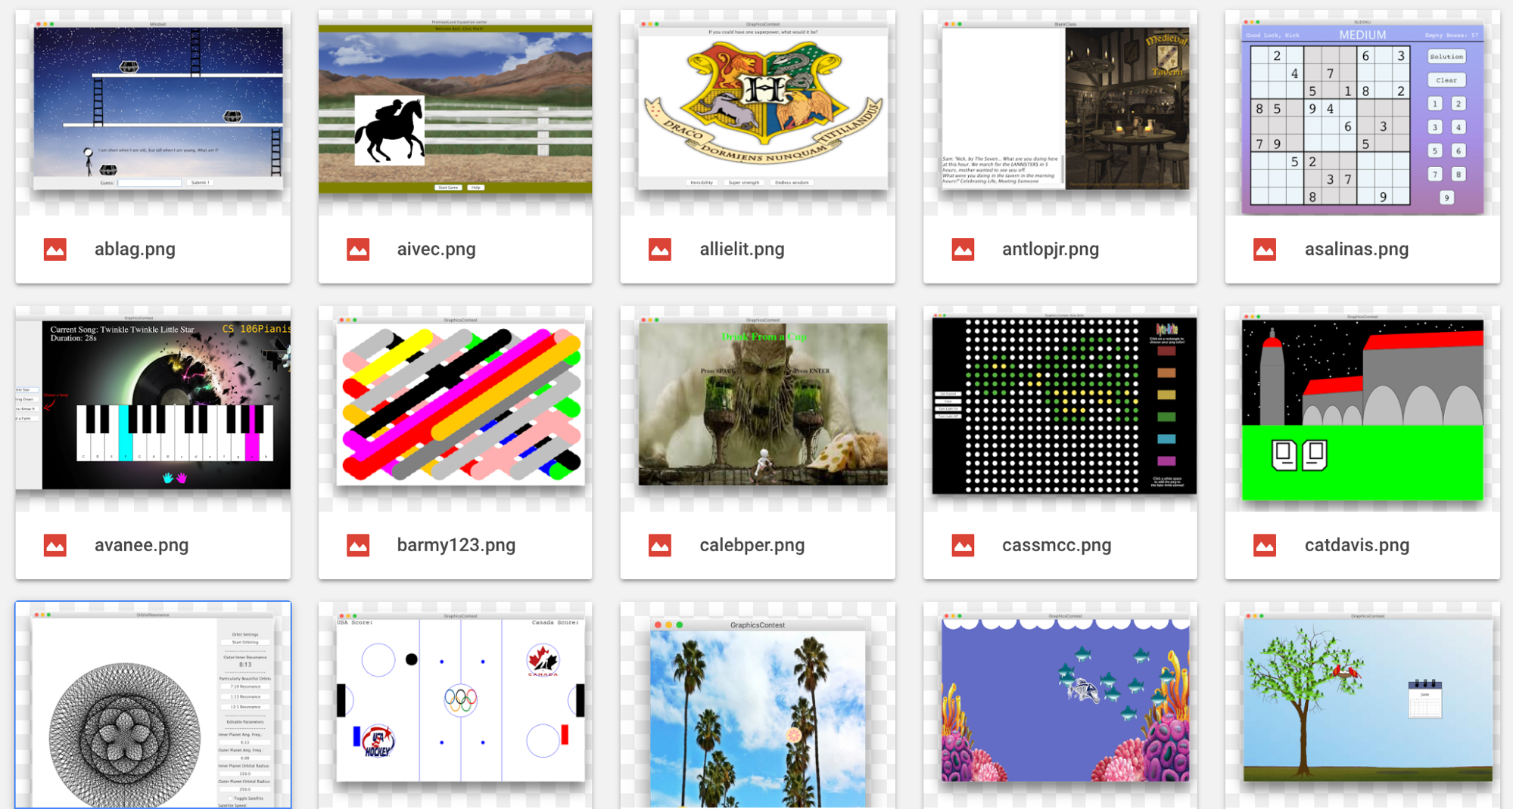

Slide 5
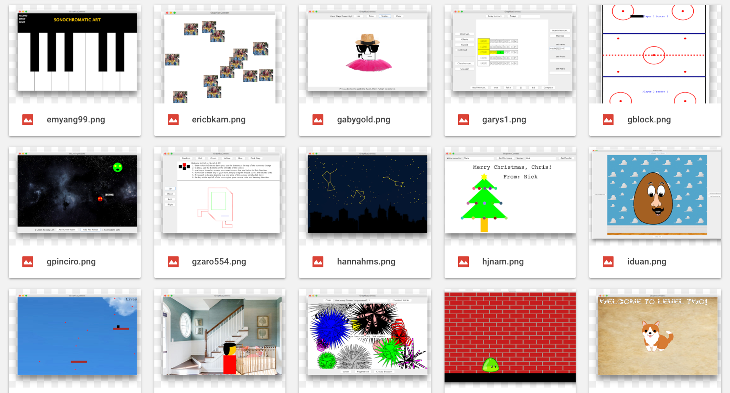

Slide 6
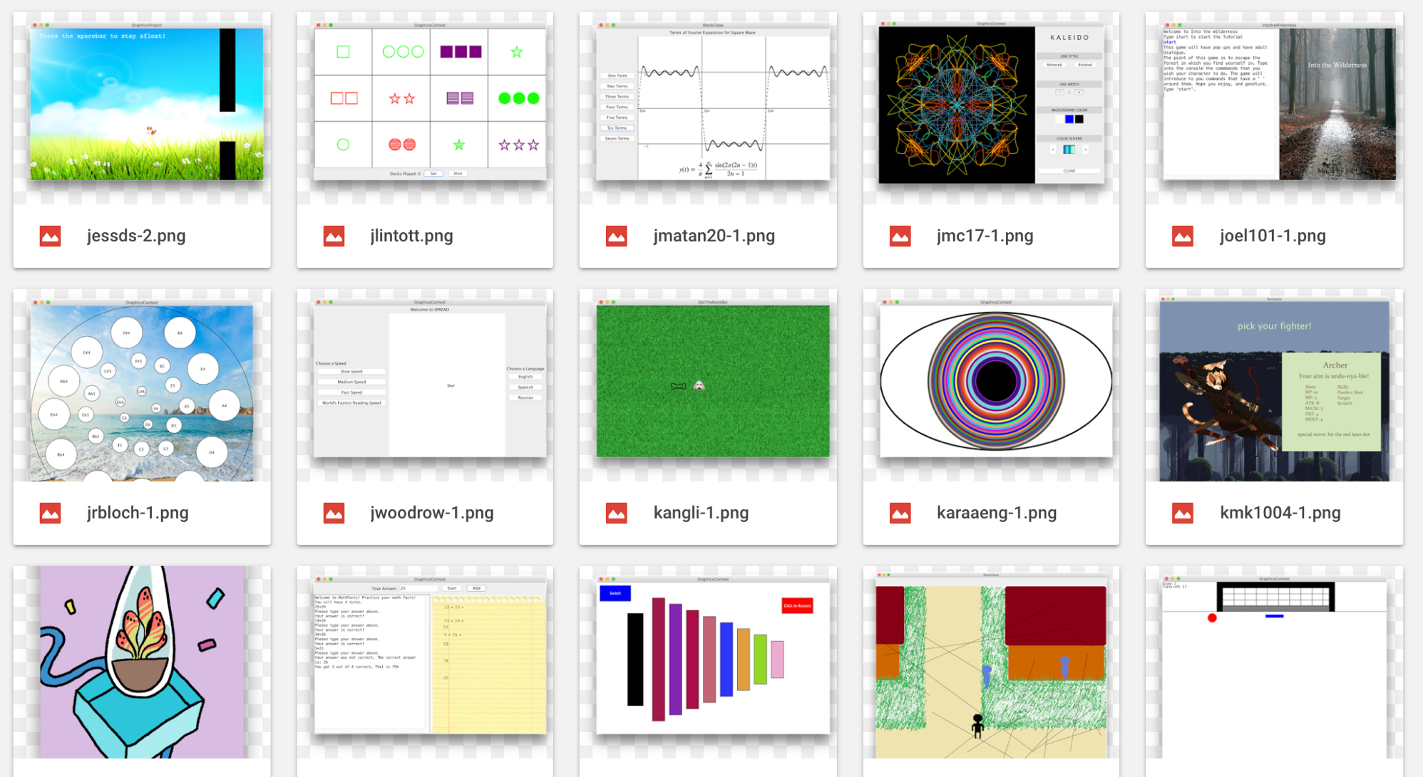

Slide 7
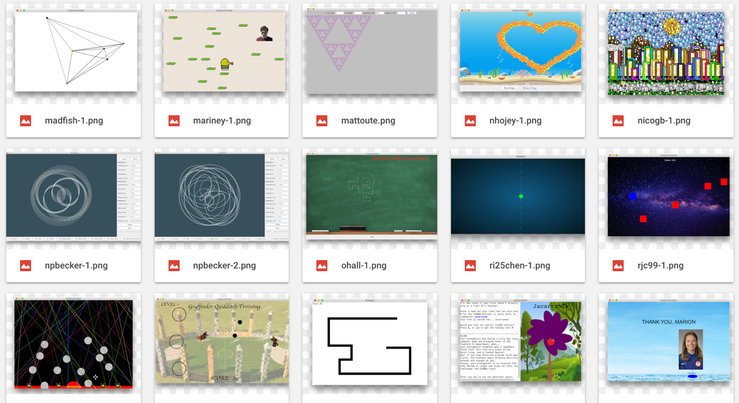

Slide 8
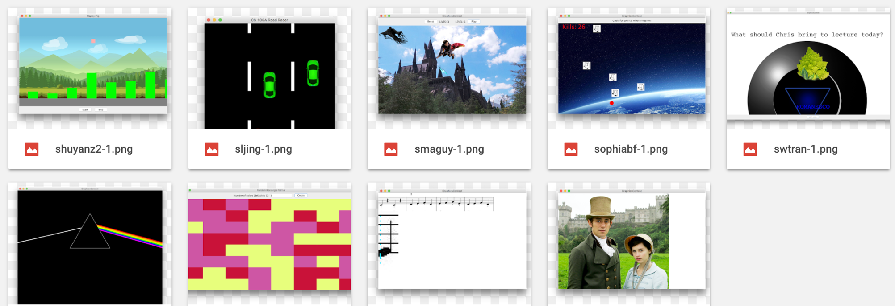

Slide 9
 | String | Array | 2D Array | ArrayList | HashMap
Model | Sequence of letters or symbols | Fixed length elements in a list | Grid / Matrix of elements | Growable list of elements | Key/Value mapping
Type of element | chars | Objects & Primitives | Objects & Primitives | Objects | Object/Object
Access Elements | str.charAt(i); | arr[i]; | arr[r][c]; | list.get(i); list.set(i, elem) list.add(elem) | map.put(key, value) map.get(key);
Special notes | Immutable | Watch bounds! | Row, col structure | Just fantastic | Each key must be unique. Unordered
Examples | ”Hello world” | Histogram | ImageShop pixels | Hangman words, entries in namesurfer | NSDatabase, FPDatabase

Slide 10
 | String | Array | 2D Array | ArrayList | HashMap
Model | Sequence of letters or symbols | Fixed length elements in a list | Grid / Matrix of elements | Growable list of elements | Key/Value mapping
Type of element | chars | Objects & Primitives | Objects & Primitives | Objects | Object/Object
Access Elements | str.charAt(i); | arr[i]; | arr[r][c]; | list.get(i); list.set(i, elem) list.add(elem) | map.put(key, value) map.get(key);
Special notes | Immutable | Watch bounds! | Row, col structure | Just fantastic | Each key must be unique. Unordered
Examples | ”Hello world” | Histogram | ImageShop pixels | Hangman words, entries in namesurfer | NSDatabase, FPDatabase

Slide 11
 | String | Array | 2D Array | ArrayList | HashMap
Model | Sequence of letters or symbols | Fixed length elements in a list | Grid / Matrix of elements | Growable list of elements | Key/Value mapping
Type of element | chars | Objects & Primitives | Objects & Primitives | Objects | Object/Object
Access Elements | str.charAt(i); | arr[i]; | arr[r][c]; | list.get(i); list.set(i, elem) list.add(elem) | map.put(key, value) map.get(key);
Special notes | Immutable | Watch bounds! | Row, col structure | Just fantastic | Each key must be unique. Unordered
Examples | ”Hello world” | Histogram | ImageShop pixels | Hangman words, entries in namesurfer | NSDatabase, FPDatabase

Slide 12
 | String | Array | 2D Array | ArrayList | HashMap
Model | Sequence of letters or symbols | Fixed length elements in a list | Grid / Matrix of elements | Growable list of elements | Key/Value mapping
Type of element | chars | Objects & Primitives | Objects & Primitives | Objects | Object/Object
Access Elements | str.charAt(i); | arr[i]; | arr[r][c]; | list.get(i); list.set(i, elem) list.add(elem) | map.put(key, value) map.get(key);
Special notes | Immutable | Watch bounds! | Row, col structure | Just fantastic | Each key must be unique. Unordered
Examples | ”Hello world” | Histogram | ImageShop pixels | Hangman words, entries in namesurfer | NSDatabase, FPDatabase

Slide 13
 | String | Array | 2D Array | ArrayList | HashMap
Model | Sequence of letters or symbols | Fixed length elements in a list | Grid / Matrix of elements | Growable list of elements | Key/Value mapping
Type of element | chars | Objects & Primitives | Objects & Primitives | Objects | Object/Object
Access Elements | str.charAt(i); | arr[i]; | arr[r][c]; | list.get(i); list.set(i, elem) list.add(elem) | map.put(key, value) map.get(key);
Special notes | Immutable | Watch bounds! | Row, col structure | Just fantastic | Each key must be unique. Unordered
Examples | ”Hello world” | Histogram | ImageShop pixels | Hangman words, entries in namesurfer | NSDatabase, FPDatabase

Slide 14
 | String | Array | 2D Array | ArrayList | HashMap
Model | Sequence of letters or symbols | Fixed length elements in a list | Grid / Matrix of elements | Growable list of elements | Key/Value mapping
Type of element | chars | Objects & Primitives | Objects & Primitives | Objects | Object/Object
Access Elements | str.charAt(i); | arr[i]; | arr[r][c]; | list.get(i); list.set(i, elem) list.add(elem) | map.put(key, value) map.get(key);
Special notes | Immutable | Watch bounds! | Row, col structure | Just fantastic | Each key must be unique. Unordered
Examples | ”Hello world” | Histogram | ImageShop pixels | Hangman words, entries in namesurfer | NSDatabase, FPDatabase

Slide 15
2D Arrays = Array of Arrays
int[][] a = new int[3][4];
a[0][0] | a[0][1] | a[0][2] | a[0][3]
a[1][0] | a[1][1] | a[1][2] | a[1][3]
Outer array
a[2][0] | a[2][1] | a[2][2] | a[2][3]

Slide 16
Strings under the hood are 1D Array of chars
String str = “cs106a”;
‘c’ | ‘s’ | ‘1’ | ‘0’ | ‘6’ | ‘a’
0
1
2
3
4
5

Slide 17
Primitives, Objects, and Heap/Stack
Tracing

Slide 18
Primitives and Objects
Primitives: int, double, boolean, char,…
Objects: GRect, GOval, GLine, int[], … (anything with new, and that you call methods on)

Slide 19
Parameters
When passing parameters, make a copy of whatever is on the stack.
Primitives: the actual value is on the stack (pass by value)
Objects: a heap address where the information lives is on the stack. (pass by reference)
Notes:
Arrays are objects! (as are arrays within arrays)

Slide 20
Parameters: Primitives
public void run() { int x = 2;
addTwo(x);
println(x); // x is still 2!
}
private void addTwo(int y) {
y += 2;
}

Slide 21
Parameters: Objects
public void run() { GRect rect = new Grect(0,0,50,50);
fillBlue(rect);
add(rect); // rect is blue!
}
private void fillBlue(GRect rect) {
rect.setFilled(true);
rect.setColor(Color.BLUE);
}

Slide 22
Program Traces
Approaching program traces
Local variables are separate across methods
Parameters are just assigned names by the order in which they’re passed
Write values above variable names as you go through the program (or draw stack frame boxes)
Pass-by-reference vs. pass-by-value

Slide 23
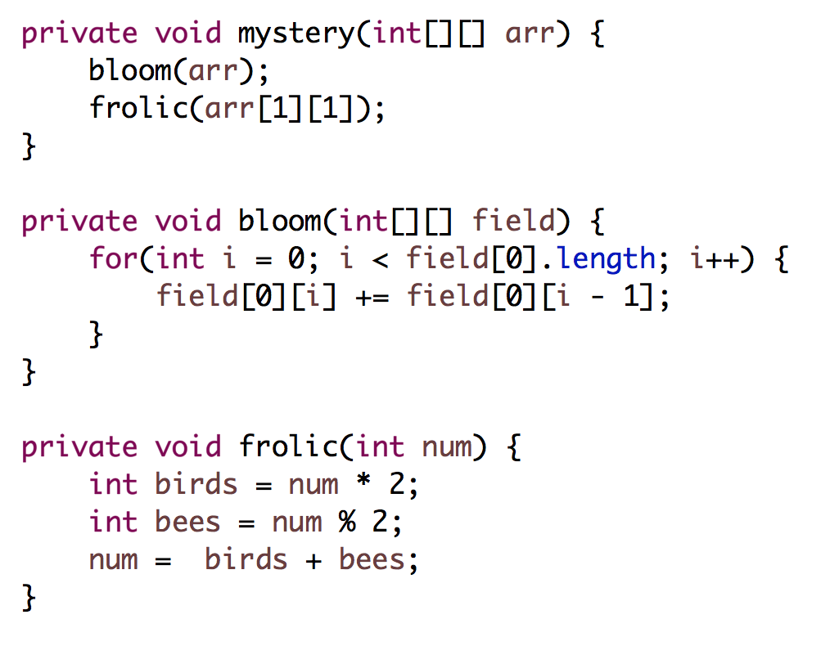
0 | 1 | 2
3 | 4 | 5
Input to mystery()
What is arr after?
Take 1
Notes:
[0, 1, 3]
[3, 4, 5]
8 never returned!

Slide 24
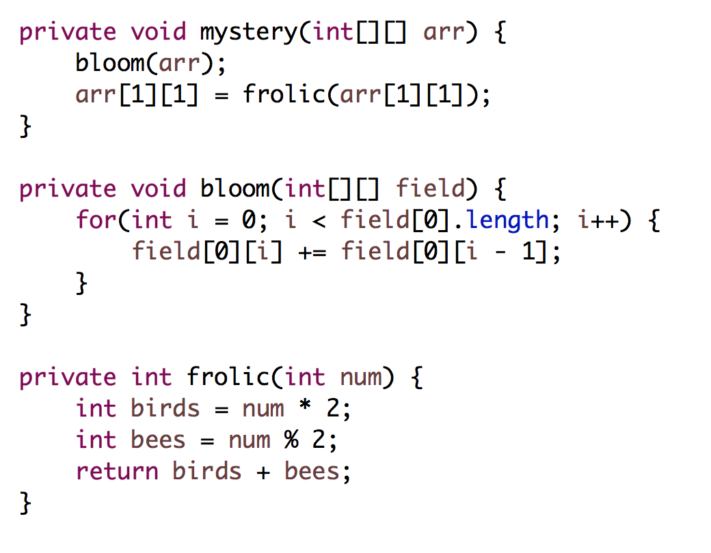
0 | 1 | 2
3 | 4 | 5
Input to mystery()
What is arr after?
Take 2
Notes:
[0, 1, 3]
[3, 8, 5]

Slide 25
Primitives, Objects, and Heap/Stack
2D Arrays

Slide 26
Get Max
// return the maximum value in the matrix
private double getMax(double[][] matrix) {

Slide 27
Get Max
// return the maximum value in the matrix
private double getMax(double[][] matrix) {
double maxValue = matrix[0][0];
for(int r = 0; r < matrix.length; r++) {
for(int c = 0; c < matrix[0].length; c++) {
if(matrix[r][c] > maxValue) {
maxValue = matrix[r][c];
}
}
}
return maxValue;
}

Slide 28
Make ASCII Art
private String[] makeAscii(GImage img) {
Original
Helper method
ASCII Art
double[][] brightness =
img.getPixelBrightness();
For each pixel chose one character to add to the corresponding row String.
If brightness greater than 0.66, use’ ‘.
If the brightness is greater than 0.33, use ‘1’.
Else, you should use the character '0'.

Slide 29
private String[] makeAscii(GImage img) {
double[][] brightness = img.getPixelBrightness();
String[] lines = new String[brightness.length];
for(int r = 0; r < lines.length; r++) {
String line = "";
for(int c = 0; c < brightness[0].length; c++) {
double v = brightness[r][c];
if(v > 0.66) {
line += ' ‘;
} else if (v > 0.66) {
line += '1’;
} else {
line += '0’;
}
}
lines[r] = line;
}
return lines;
}

Slide 30
private String[] makeAscii(GImage img) {
double[][] brightness = img.getPixelBrightness();
String[] lines = new String[brightness.length];
for(int r = 0; r < lines.length; r++) {
String line = "";
for(int c = 0; c < brightness[0].length; c++) {
double v = brightness[r][c];
if(v > 0.66) {
line += ' ‘;
} else if (v > 0.66) {
line += '1’;
} else {
line += '0’;
}
}
lines[r] = line;
}
return lines;
}

Slide 31
private String[] makeAscii(GImage img) {
double[][] brightness = img.getPixelBrightness();
String[] lines = new String[brightness.length];
for(int r = 0; r < lines.length; r++) {
String line = "";
for(int c = 0; c < brightness[0].length; c++) {
double v = brightness[r][c];
if(v > 0.66) {
line += ' ‘;
} else if (v > 0.66) {
line += '1’;
} else {
line += '0’;
}
}
lines[r] = line;
}
return lines;
}

Slide 32
private String[] makeAscii(GImage img) {
double[][] brightness = img.getPixelBrightness();
String[] lines = new String[brightness.length];
for(int r = 0; r < lines.length; r++) {
String line = "";
for(int c = 0; c < brightness[0].length; c++) {
double v = brightness[r][c];
if(v > 0.66) {
line += ' ‘;
} else if (v > 0.66) {
line += '1’;
} else {
line += '0’;
}
}
lines[r] = line;
}
return lines;
}

Slide 33
private String[] makeAscii(GImage img) {
double[][] brightness = img.getPixelBrightness();
String[] lines = new String[brightness.length];
for(int r = 0; r < lines.length; r++) {
String line = "";
for(int c = 0; c < brightness[0].length; c++) {
double v = brightness[r][c];
if(v > 0.66) {
line += ' ‘;
} else if (v > 0.66) {
line += '1’;
} else {
line += '0’;
}
}
lines[r] = line;
}
return lines;
}

Slide 34
private String[] makeAscii(GImage img) {
double[][] brightness = img.getPixelBrightness();
String[] lines = new String[brightness.length];
for(int r = 0; r < lines.length; r++) {
String line = "";
for(int c = 0; c < brightness[0].length; c++) {
double v = brightness[r][c];
if(v > 0.66) {
line += ' ‘;
} else if (v > 0.66) {
line += '1’;
} else {
line += '0’;
}
}
lines[r] = line;
}
return lines;
}

Slide 35
Primitives, Objects, and Heap/Stack
Array List

Slide 36
ArrayList
An ArrayList is a flexible-length list of a single type of thing.
An ArrayList can only store objects.
For primitives use e.g. ArrayList<Integer> instead of ArrayList<int>. (Integer is a wrapper class for int)
Other wrapper classes: Double instead of double, Character instead of char, Boolean instead of boolean.
An ArrayList has a variety of methods you can use like .contains, .get, .add, .remove, .size, etc.

Slide 37
Array vs ArrayList
Array
Fixed size
Efficient (not a concern in this class)
No methods, can only use myArray.length (no parentheses!)
Can store any object or primitive
ArrayList
Expandable
Less efficient than Array (not a concern in this class)
Convenient methods like .add(), .remove(), .contains()
Cannot store primitives, so use their wrapper classes instead

Slide 38
deleteDuplicates()
private void deleteDuplicates(ArrayList<String> list)
Guaranteed that list is in sorted order
{"be", "be", "is", "not", "or”, "or”, "or", "question", "that", "the", "to"} becomes {“be”, “is”, “not”, “or”, “question”, “that”, “the”, “to”}
Solution strategy:
Loop through ArrayList
Compare pairs of elements
If element.equals(nextElement), remove element from the list

Slide 39
deleteDuplicates()
0
1
2
3
4
5
6
7
8
9
10
List
{"be", "be", "is", "not", "or”, "or”, "or", "question", "that", "the", "to"}
curr
next
Current Index (i):
0

Slide 40
deleteDuplicates()
0
1
2
3
4
5
6
7
8
9
10
List
{"be", "be", "is", "not", "or”, "or”, "or", "question", "that", "the", "to"}
curr
next
Current Index (i):
0

Slide 41
deleteDuplicates()
0
1
2
3
4
5
6
7
8
9
10
List
{"be", "be", "is", "not", "or”, "or”, "or", "question", "that", "the", "to"}
Current Index (i):
0

Slide 42
deleteDuplicates()
0
1
2
3
4
5
6
7
8
9
List
{"be", "is", "not", "or”, "or”, "or", "question", "that", "the", "to"}
Current Index (i):
0

Slide 43
deleteDuplicates()
0
1
2
3
4
5
6
7
8
9
List
{"be", "is", "not", "or”, "or”, "or", "question", "that", "the", "to"}
Current Index (i):
1

Slide 44
deleteDuplicates()
0
1
2
3
4
5
6
7
8
9
List
{"be", "is", "not", "or”, "or”, "or", "question", "that", "the", "to"}
curr
next
Current Index (i):
1

Slide 45
Sometime later…

Slide 46
deleteDuplicates()
0
1
2
3
4
5
6
7
8
9
List
{"be", "is", "not", "or”, "or”, "or", "question", "that", "the", "to"}
curr
next
Current Index (i):
3

Slide 47
deleteDuplicates()
0
1
2
3
4
5
6
7
8
9
List
{"be", "is", "not", "or”, "or”, "or", "question", "that", "the", "to"}
curr
next
Current Index (i):
3

Slide 48
deleteDuplicates()
0
1
2
3
4
5
6
7
8
9
List
{"be", "is", "not", "or”, "or”, "or", "question", "that", "the", "to"}
Current Index (i):
3

Slide 49
deleteDuplicates()
0
1
2
3
4
5
6
7
8
List
{"be", "is", "not", "or”, "or", "question", "that", "the", "to"}
Current Index (i):
3

Slide 50
deleteDuplicates()
4
8
0
1
2
3
4
5
6
7
List
{"be", "is", "not", "or”, "or", "question", "that", "the", "to"}
Current Index (i):
4

Slide 51
deleteDuplicates()
0
1
2
3
4
5
6
7
8
List
{"be", "is", "not", "or”, "or", "question", "that", "the", "to"}
curr
next
Current Index (i):
4

Slide 52
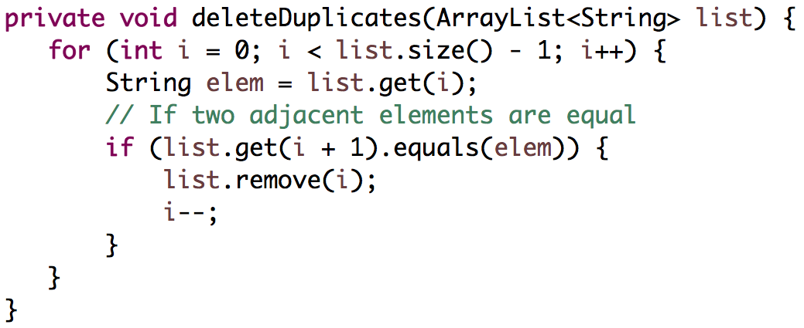
deleteDuplicates()
Loop through ArrayList
Compare pairs of elements
If element.equals(nextElement), remove element from the list
Strategy #1

Slide 53
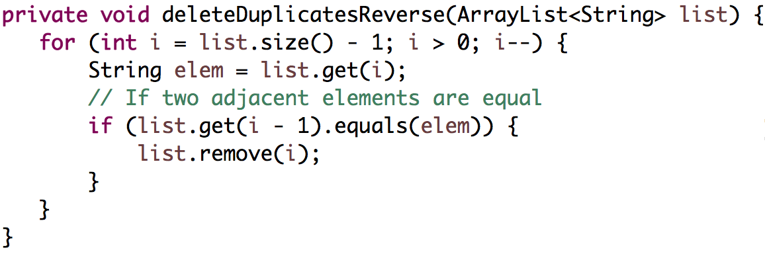
deleteDuplicates()
Loop through ArrayList in reverse
Compare pairs of elements
If element.equals(previousElement), remove element from the list
Strategy #2

Slide 54
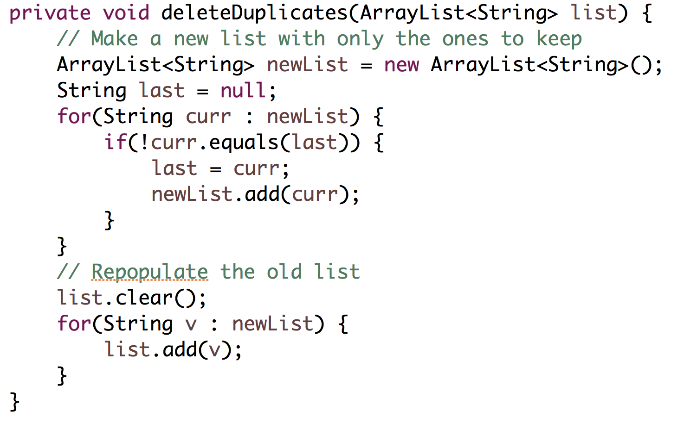
deleteDuplicates()
Strategy #3

Slide 55
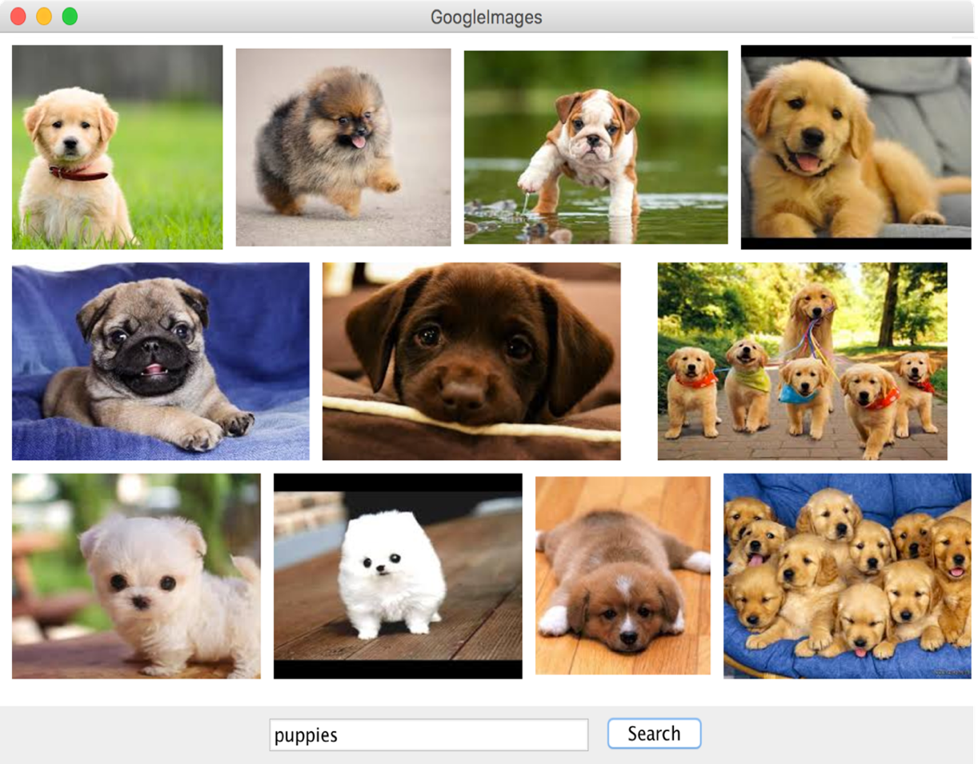
Google Images
public void displayQuery(String query) {
1
2
3
4
Use a helper method:
ArrayList<GImage> results =
getSearchResults(query);
5
6
7
display your images in three rows of fixed height ROW_HEIGHT . You can scale images, but should maintain the ratio of their width to height. You can change the size of a GImage using it’s
setSize(width, height) method
8
9
There is a spacing of GAP pixels between each picture. You can optionally include the GAP between the pictures and the border of the window.
No image should go off the screen. You should not display all 100 returned images – only display the ones that fit into the three rows.

Slide 56
You have come a long way

Slide 58
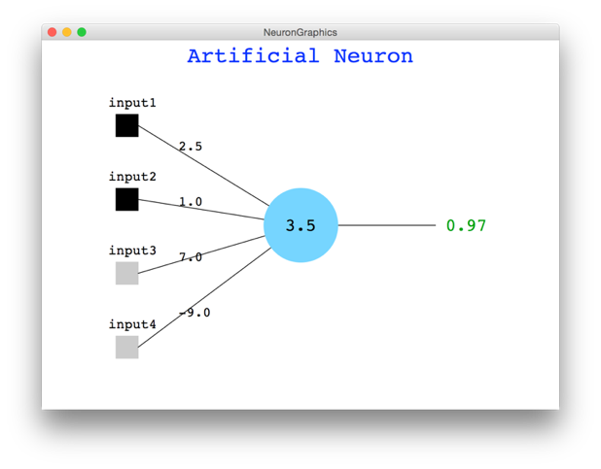


Slide 59
You have my respect.

Slide 60
Why Study CS?

Slide 61
Joy of Building

Slide 62
Interdisciplinary

Slide 63

Closest Thing To Magic

Slide 64


Now is the Time

Slide 65

Everyone is Welcome
Notes:
One of my favorite things about programming is that we are all equal infront of Eclispe.
Eclipse does not care your ethnicity, gender, orientation.
That theme is part of the essence of CS106A.
Last night Oprah talked about the new day that is on the horizon! CS too is having a new day and it is very exciting future for the phenomenal women and men sitting in this classroom.

Slide 66
The End

Slide 67
public void displayQuery(String query) {
ArrayList<GImage> results = getSearchResults(query);
int index = 0;
int row = 0;
int currX = GAP;
int currY = GAP;
while(row < 3) {
GImage img = results.get(index);
double ratio = img.getWidth() / img.getHeight();
double width = ROW_HEIGHT * ratio;
if(currX + width < getWidth()) {
add(img, currX, currY);
currX += width + GAP;
index++;
} else {
row++;
currX = GAP;
currY += ROW_HEIGHT + GAP;
}
}
}

